Slide 1

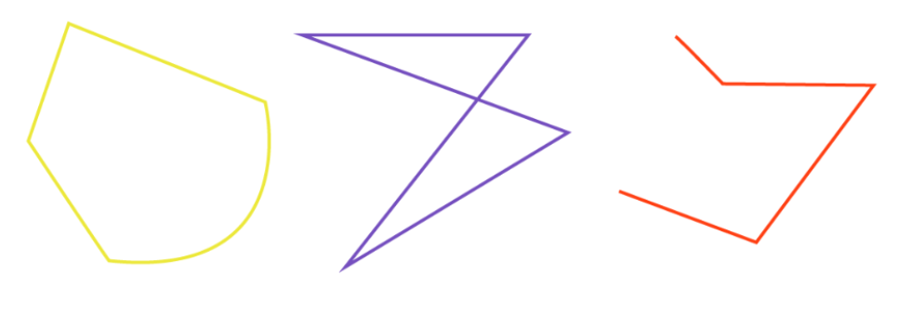
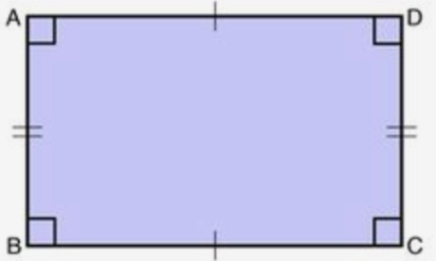
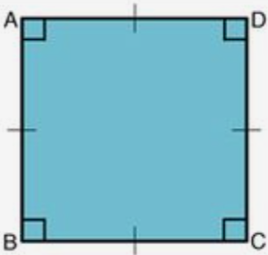
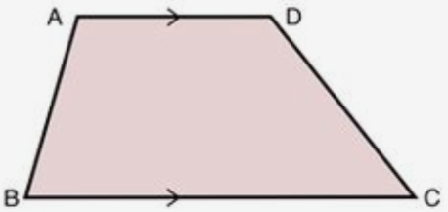
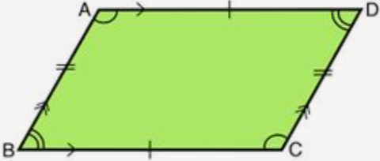
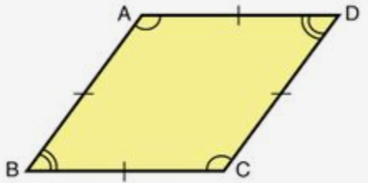
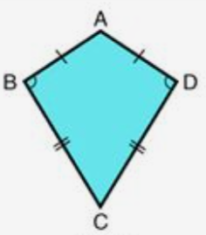
Subtopic G1.6 - Naming, labelling and recognising the features of quadrilaterals
LEARNING OUTCOME: To be confident identifying quadrilaterals and solving problems related to their angles
Objectives:
Keywords:
- Quadrilateral
- Parallel
- Perpendicular
To find a missing interior angle in a quadrilateral.
To solve multi-step angle problems involving quadrilaterals.
Definition
A two-dimensional shape made of 4 connected straight lines that create 4 interior angles
Characteristics
4 straight sides and 4 angles
Two dimensional
Angles sum to 360º
Quadrilateral
Examples
Non - Examples
TYPES OF SPECIAL QUADRILATERALS
_______________________ | _______________________ | _______________________
Opposite sides are equal Adjacent sides are perpendicular | All four sides are equal Adjacent sides are perpendicular | One pair of parallel sides
_______________________ | _______________________ | _______________________
2 pairs of parallel sides Opposite sides are equal | 2 pairs of parallel sides All four sides are equal | Two pairs of equal sides which are adjacent
Rectangle Square Trapezium
Parallelogram Rhombus Kite

Slide 2
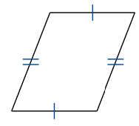
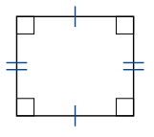
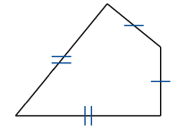
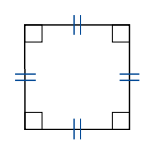
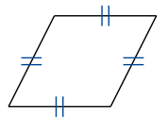
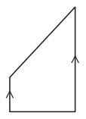
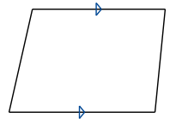
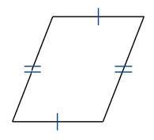
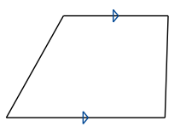
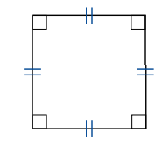
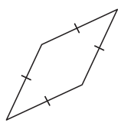
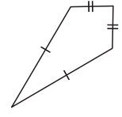

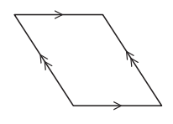
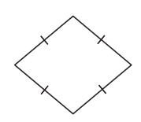
 | Example 1 – I do… | Example 2 – We do… | Example 3 – You do…
Steps | What type of quadrilateral is shown?
Look for a feature of the quadrilateral listed above Write down which type of quadrilateral it is
Parallelogram Rectangle Kite
Independent Practice
Question 1. Identify which type of quadrilateral is shown.
a) _______________________ | b) _______________________ | c) _______________________
d) _______________________ | e) _______________________ | f) _______________________
g) _______________________ | h) _______________________ | i) _______________________
j) _______________________ | k) _______________________ | l) _______________________
Square Rhombus Trapezium
Trapezium Trapezium Parallelogram
Square Rhombus Kite
Rectangle Parallelogram Rhombus

Slide 3
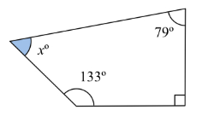
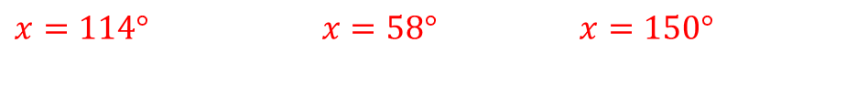
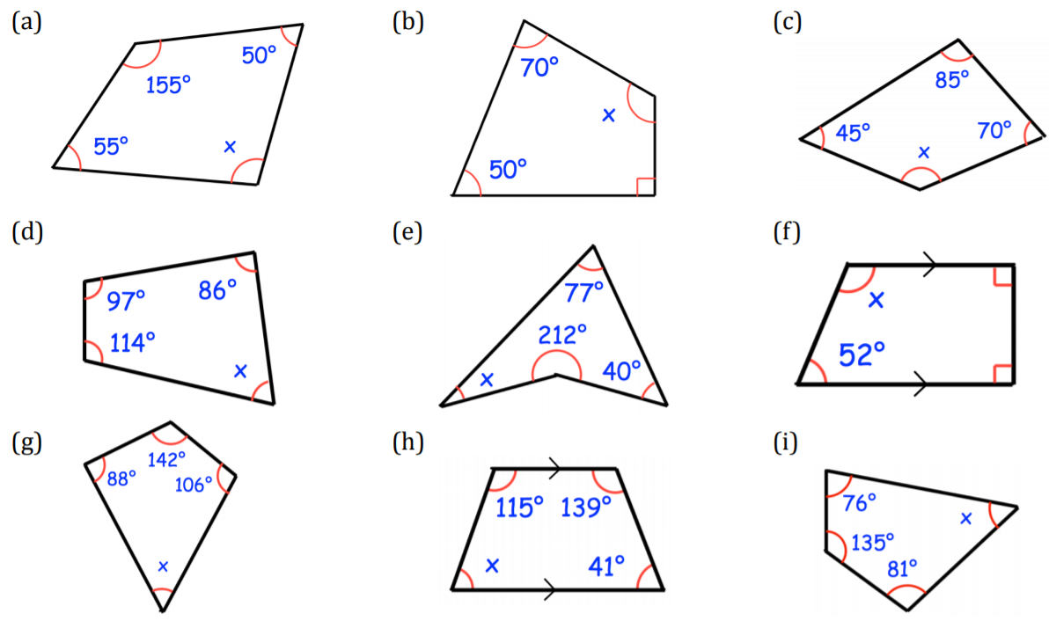



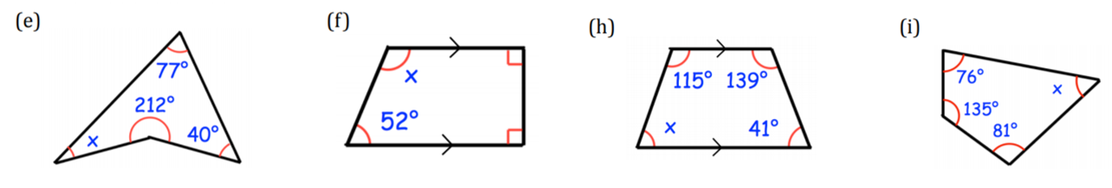



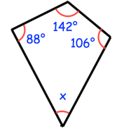



Angles in a quadrilateral
Example 4 - I do…
Example 5 - We do…
Example 6 – You do…
Steps | Calculate the missing angle
Identify the four interior angles of the quadrilateral. Subtract from 360° to find the missing angle
107°
81°
53°
x
58°
x
95°
62°
Independent Practice
Question 2. Calculate any missing angles
a) | b) | c)
d) | e) | f)
g) | h) | i)

Slide 4
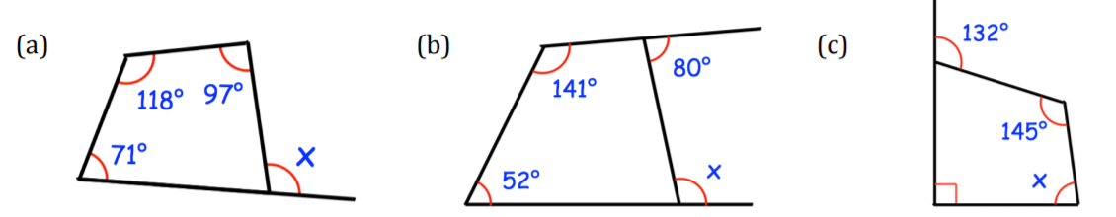
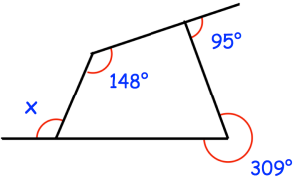






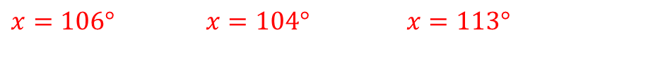
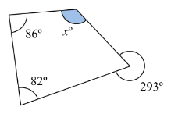
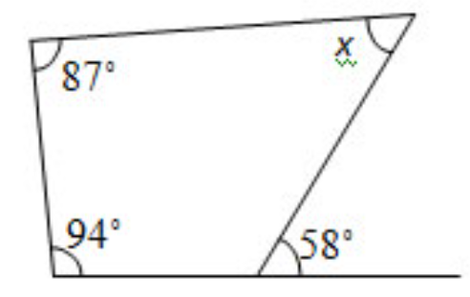
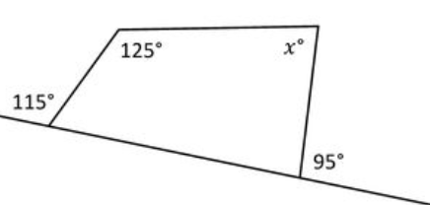







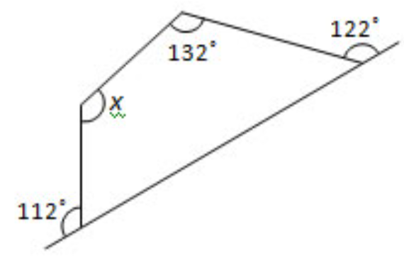
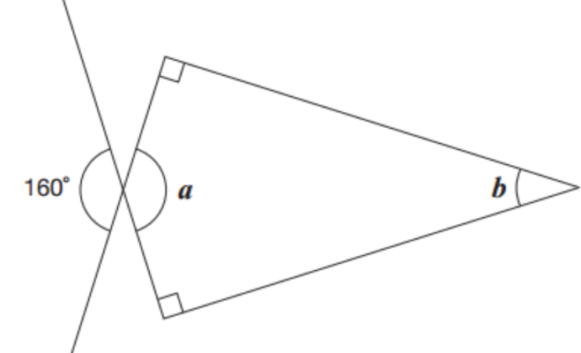







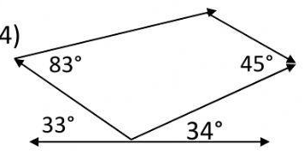
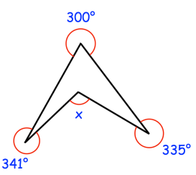

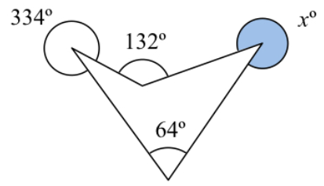











Example 7 - I do…
Example 8 - We do…
Example 9 – You do…
Steps | Calculate the missing angle
Identify the four interior angles of the quadrilateral. Subtract from 360° to find the missing angle in the quadrilateral Use other angle facts to find x
Independent Practice
Question 3. Calculate any missing angles
a) | b) | c)
d) | e) | f)
g) | h) | i)

Slide 5

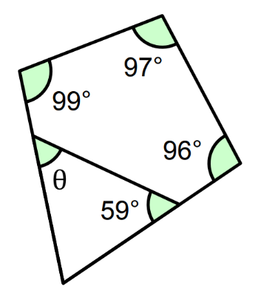
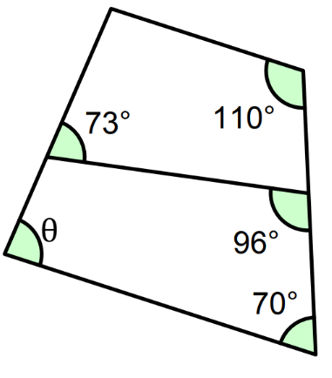
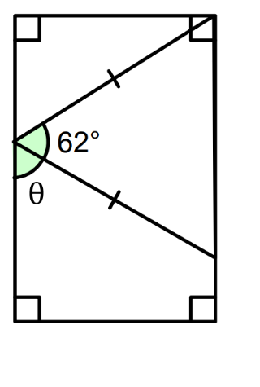







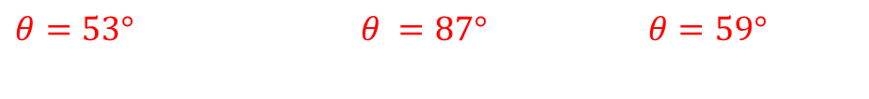

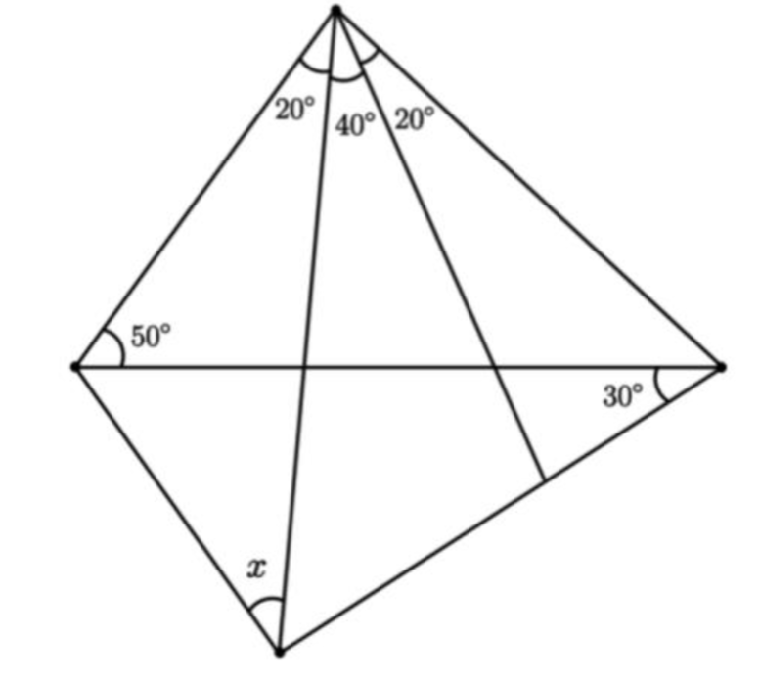
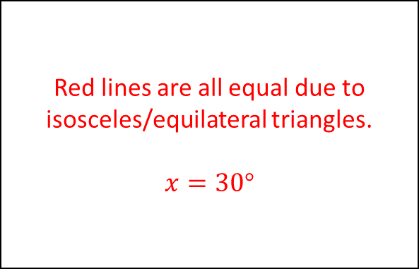










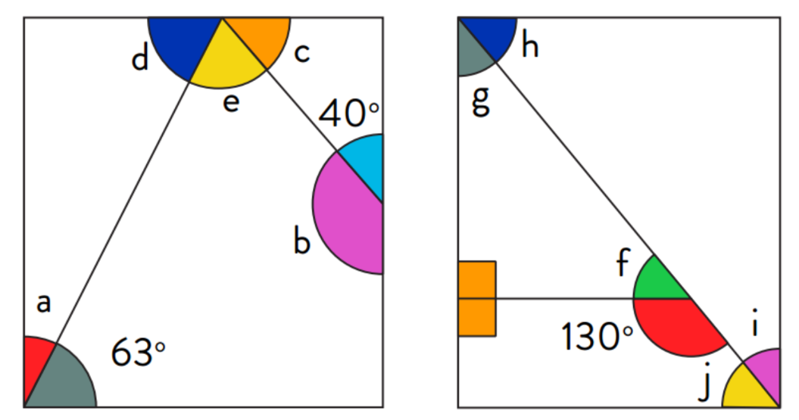
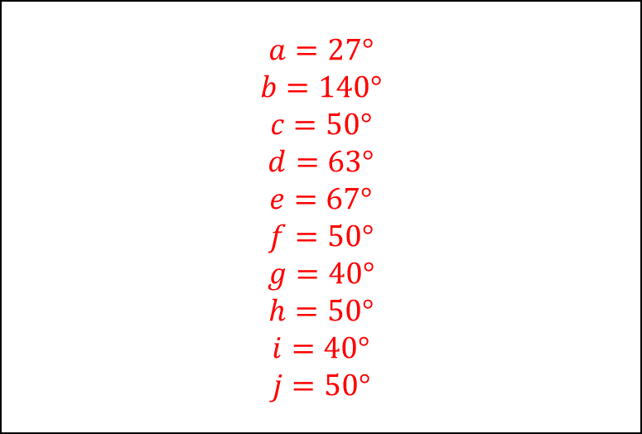
a) | b) | c)
Question 6. Calculate all the missing angles

Slide 6
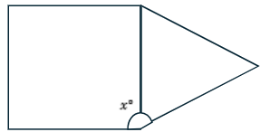
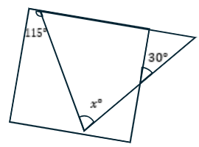


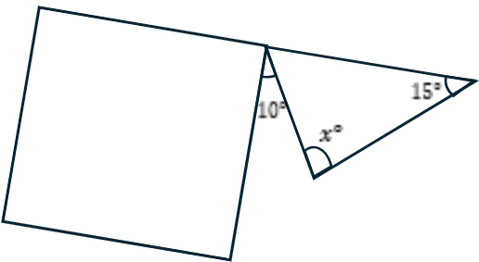
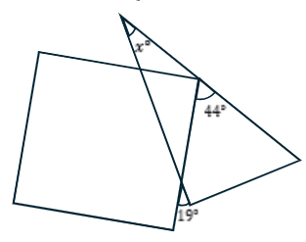


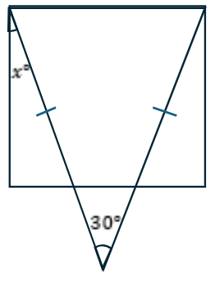



Mixed Practice (CHALLENGE)
Question 7. Calculate angle x in each of the following questions:
a) | b)
c) | d)
e) | f)

Slide 7




Skills Check
What type of quadrilateral is this?
a) Trapezium b) Parallelogram
c) Rectangle d) Kite
Which of the following best describe the features of a kite?
Two pairs of parallel sides
Two pairs of equal opposite sides
Two pairs of equal adjacent sides
One pair of equal sides
Find the missing angle.
a) 263º b) 112º
c) 83º d) 97º
Find the missing angle.

